Slide 1


Tredence- Data Science Program
Decision Tree
EMPOWERING High Performance Technology Teams

Slide 2
Agenda
Revision
What is a Decision Tree?
Components of Decision Tree.
Decision tree algorithms: ID3
When to stop splitting?
Pruning
Final comments
Demo
Practice Exercise
Decision Tree Regression
Demo

Slide 3
Revision
Classification is-
A. Unsupervised learning
B. Reinforcement learning
C. Supervised learning
D. None

Slide 4
Revision
You have a dataset of different flowers containing their petal lengths and color. Your model has to predict the type of flower for given petal lengths and color. This is a-
Regression task
B. Classification task
C. Clustering task
D. None

Slide 5
Revision
With the help of a confusion matrix, we can compute-
A. Recall
B. Precision
C. Accuracy
D. All of the above

Slide 6
Revision
Which one is a different algorithm?
A. Logistic Regression
B. Support Vector Regression
C. Polynomial Regression
D. None

Slide 7
Revision
Which metric is not used for evaluating classification models?
A. AUC ROC score
B. Accuracy
C. Mean absolute error
D. Precision

Slide 8
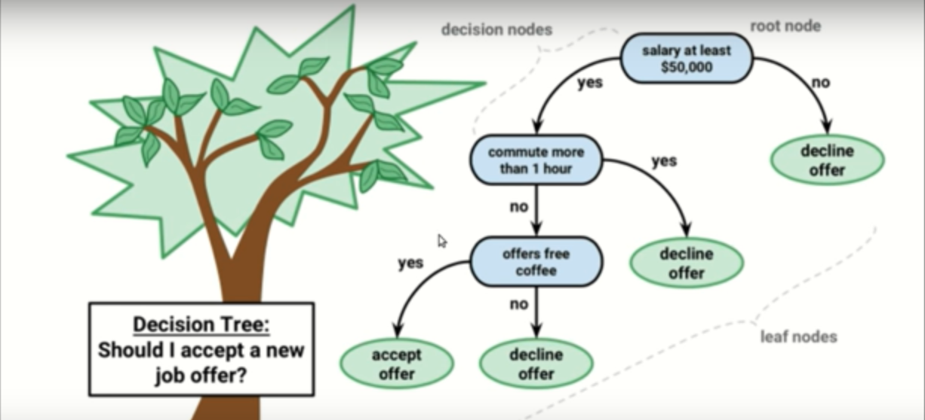
What is a Decision Tree?

Slide 9
What is Decision Tree?
It is a tool that has applications spanning several different areas.
Decision trees can be used for classification as well as regression problems.
The name itself suggests that it uses a flowchart like a tree structure to show the predictions that result from a series of feature-based splits.
It starts with a root node and ends with a decision made by leaves.

Slide 10
Components of a Decision Tree
Decision Node: Representing feature or attribute
Branches: Representing Decision or rule
Leaf Nodes: Representing the final outcome

Slide 11
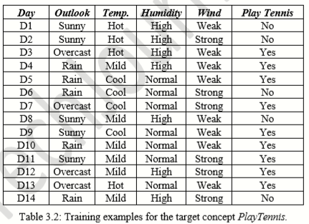
Make a decision tree that predicts whether tennis can be played or not.

Slide 12
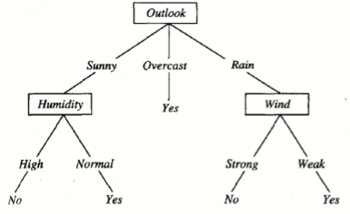
Decision Tree

Slide 13
Decision tree algorithms are:
Two types:
ID3 (Iterative Dichotomiser 3)
CART (Classification And Regression Tree)
Algorithm we are going to use in decision trees:
ID3 (Iterative Dichotomiser 3) → uses Entropy function and Information gain as metrics.

Slide 14
Step 1: Create a root node
How to choose the root node?
Choose the attribute that best classifies the data.
How to choose the best attribute?
Here come the ID3 algorithm

Slide 15
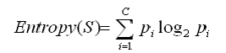
Entropy
A formula to calculate the homogeneity of a sample.
A completely homogeneous sample has entropy of 0.
An equally divided sample has entropy of 1.
Entropy(s) = - p+log2 (p+) -p-log2 (p-) for a sample of negative and positive elements.
The formula for entropy is:

Slide 16
Entropy
Entropy(S) = - (9/14) Log2 (9/14) - (5/14) Log2 (5/14) = 0.940

Slide 17
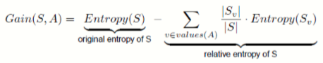
Information Gain:
The information gain is based on the decrease in entropy after a dataset is split on an attribute.
Which attribute creates the most homogeneous branches?
First the entropy of the total dataset is calculated.
The dataset is then split on the different attributes.
The entropy for each branch is calculated. Then it is added proportionally, to get total entropy for the split.
The resulting entropy is subtracted from the entropy before the split.
The result is the Information Gain, or decrease in entropy.
The attribute that yields the largest IG is chosen for the decision node.

Slide 18
Steps
Compute the Entropy of the complete dataset Entropy(S)
For every Attribute / Feature:
Calculate the Entropy for all other values
Calculate the Information Gain
Pick the attribute with the highest Information Gain.
Repeat until we get the desired tree.

Slide 19
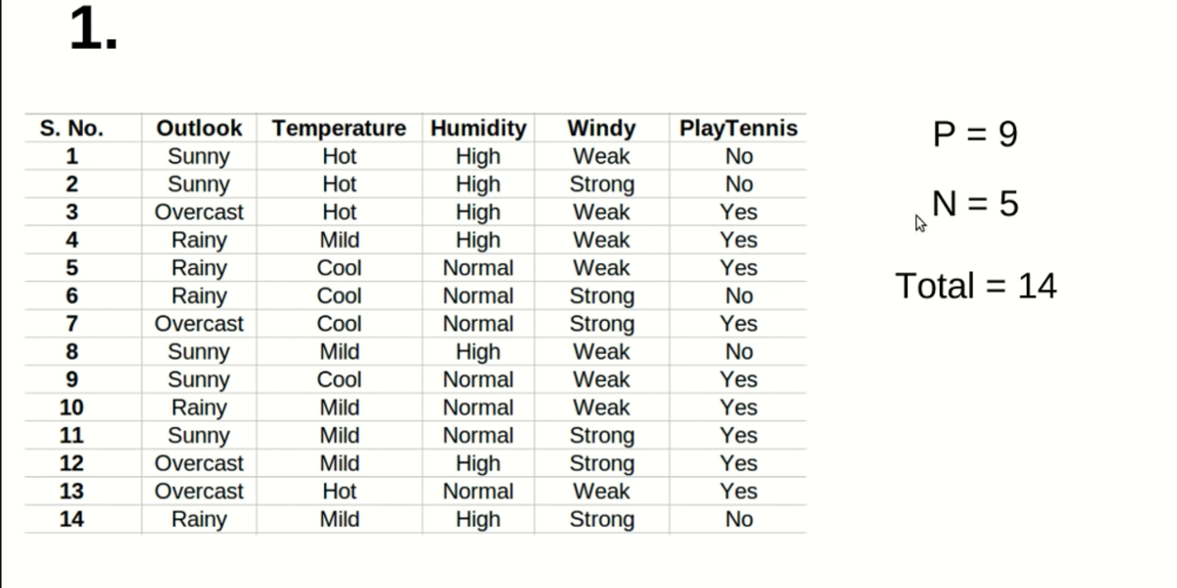

Slide 20
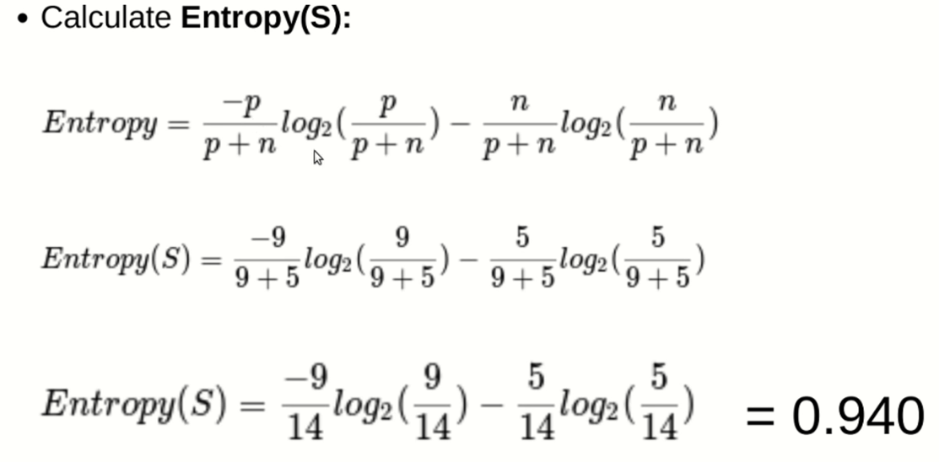

Slide 21
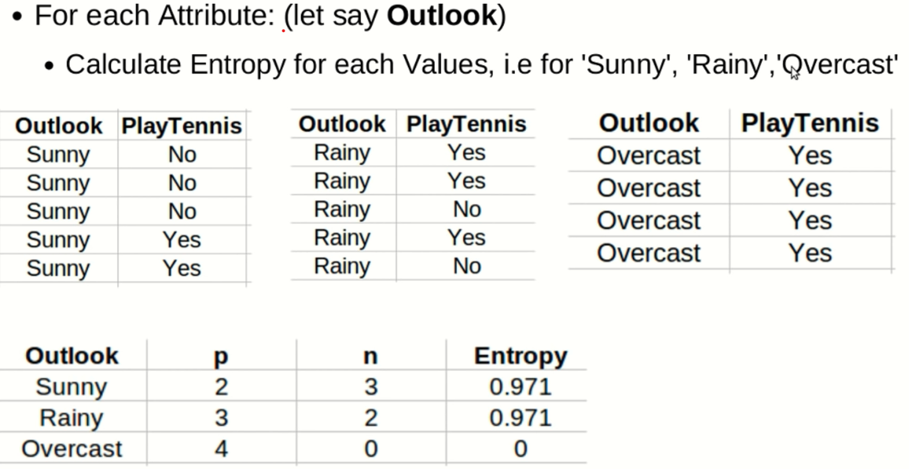

Slide 22
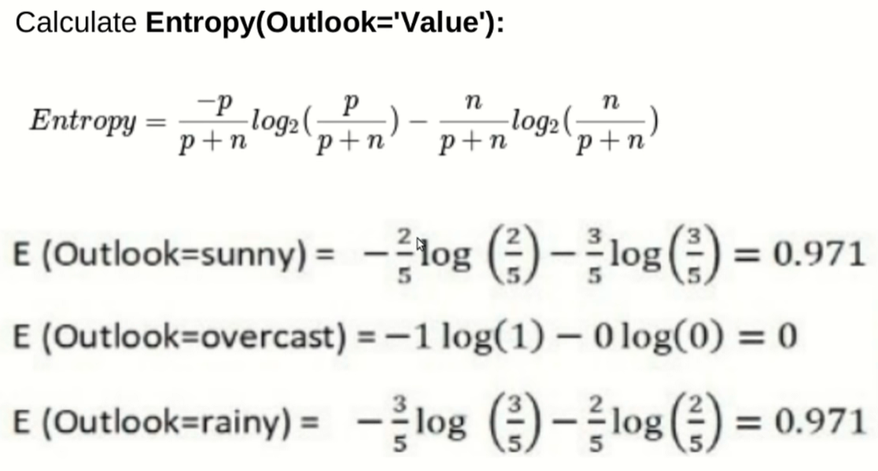

Slide 23
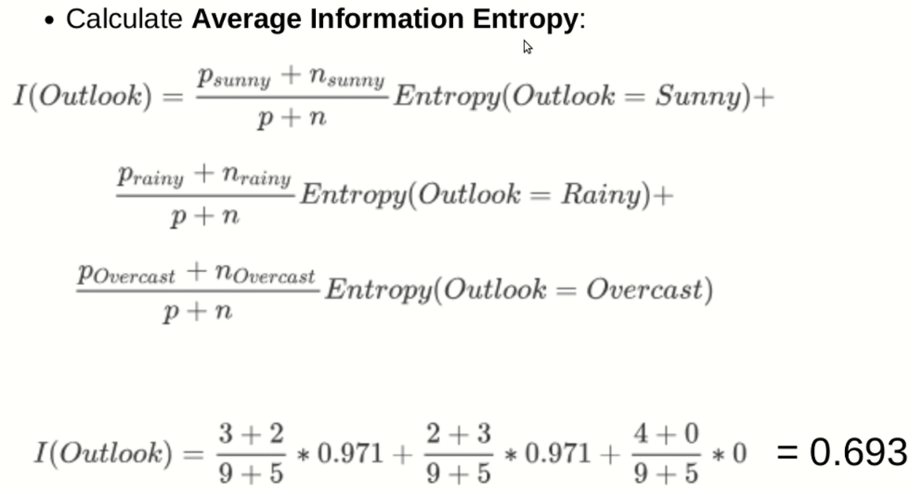

Slide 24
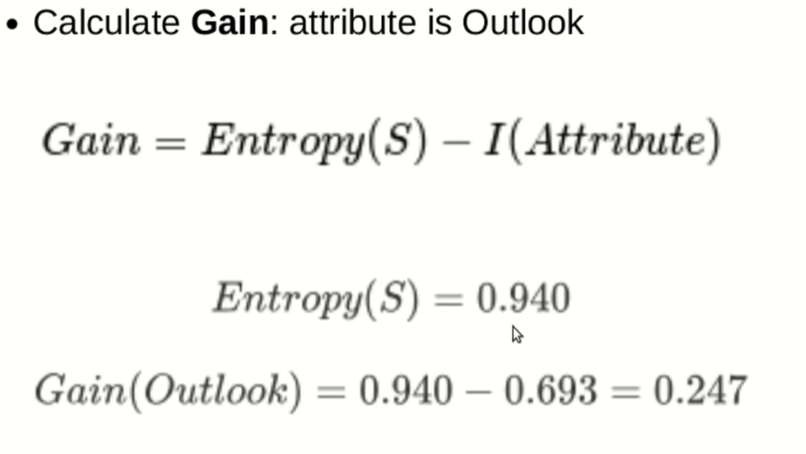

Slide 25
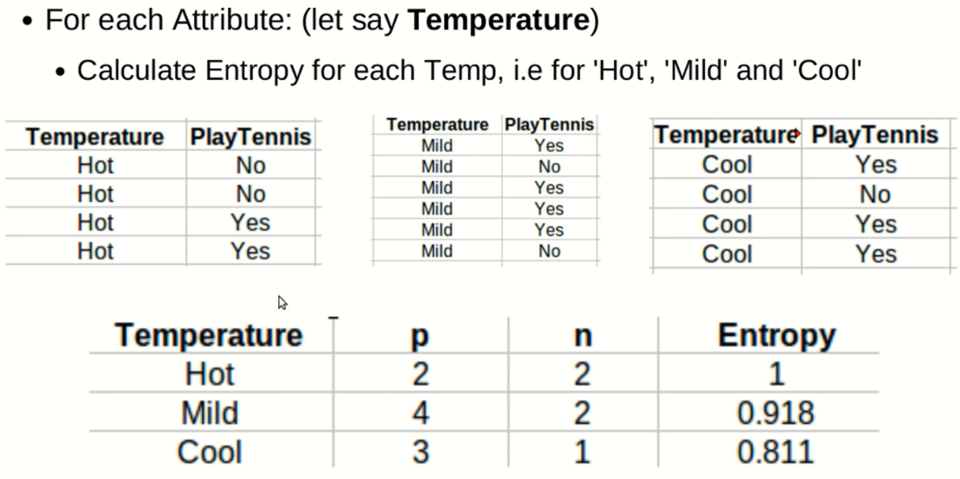

Slide 26
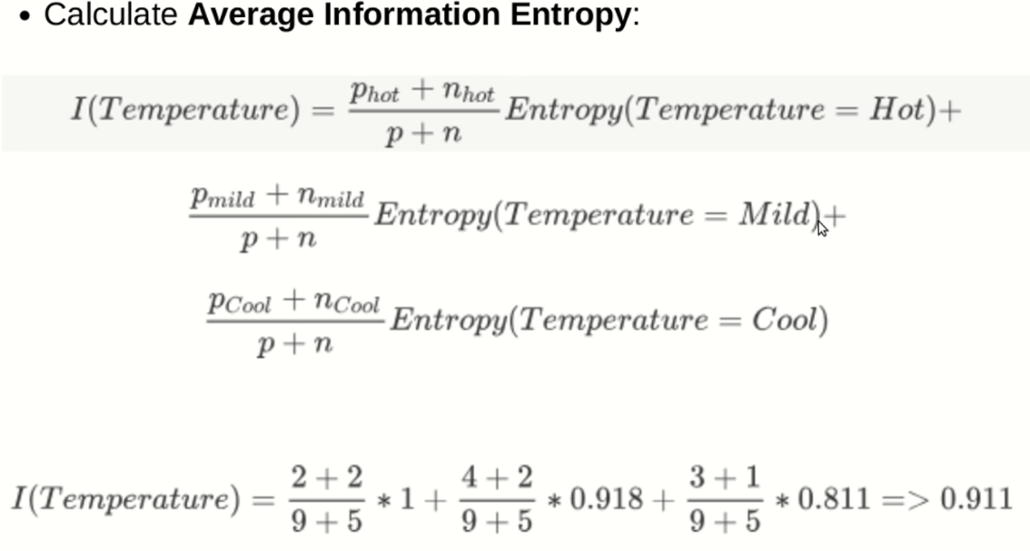

Slide 27
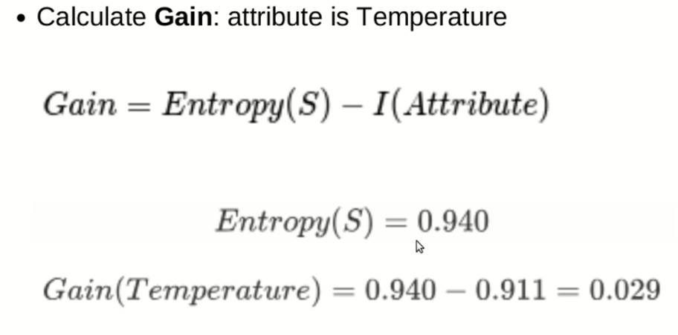

Slide 28
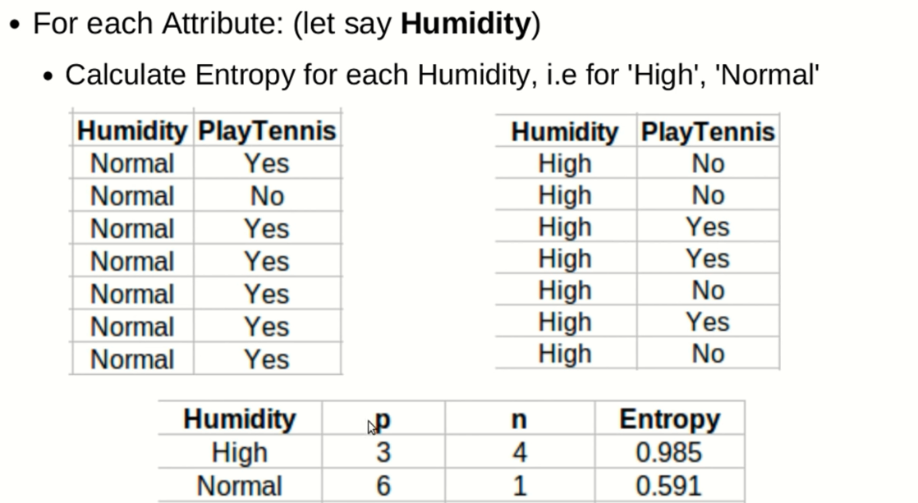

Slide 29
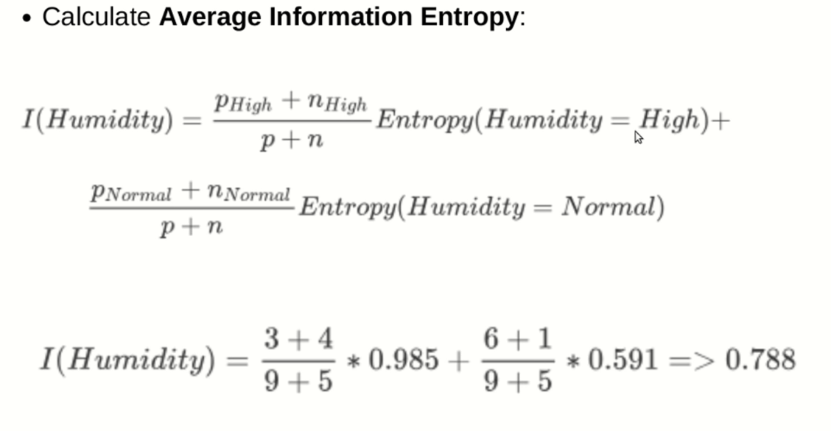

Slide 30
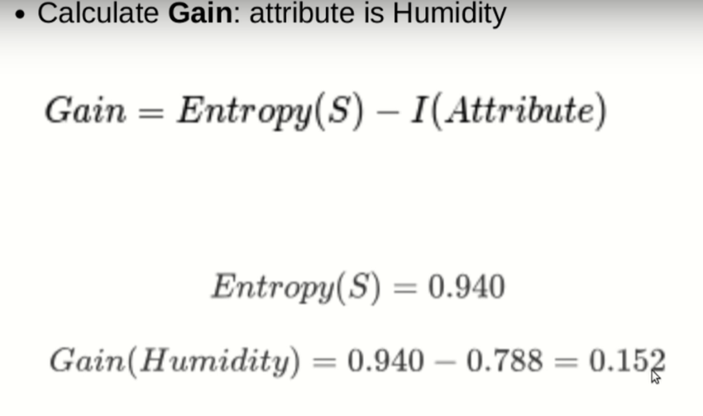

Slide 31
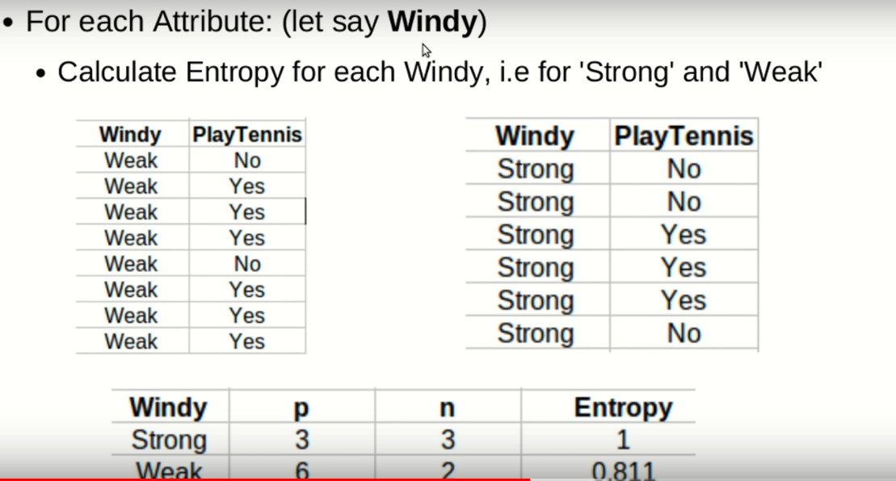

Slide 32
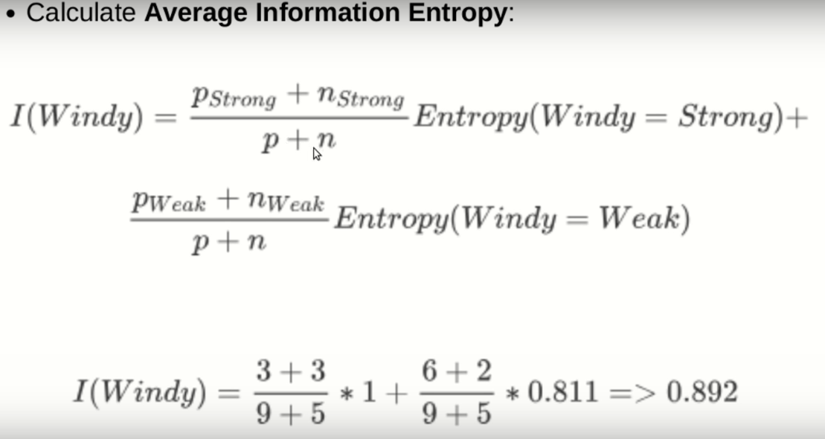

Slide 33
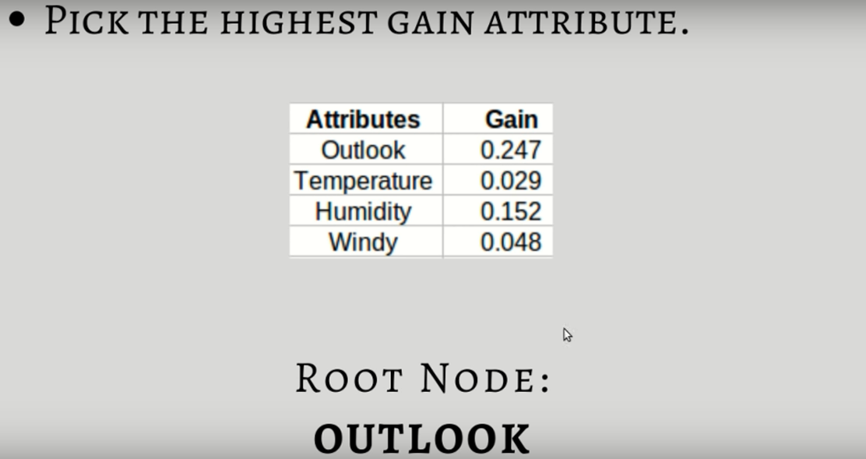

Slide 34
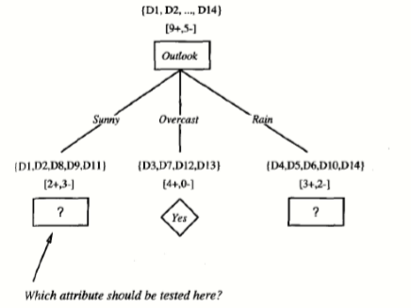

Slide 35
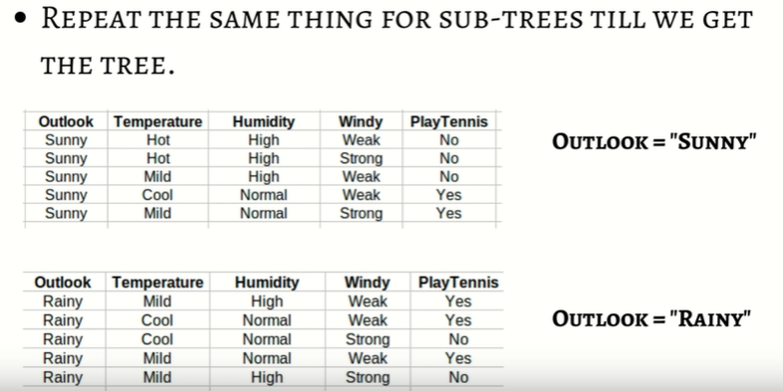

Slide 36
When to stop splitting?
Usually, real-world datasets have a large number of features, which will result in a large number of splits, which in turn gives a huge tree.
Such trees take time to build and can lead to overfitting. That means the tree will give very good accuracy on the training dataset but will give bad accuracy in test data.
There are many ways to tackle this problem through hyperparameter tuning.
We can set the maximum depth of our decision tree using the max_depth parameter.
Another way is to set the minimum number of samples for each spilt. It is denoted by min_samples_split.
min_samples_leaf – represents the minimum number of samples required to be in the leaf node. The more you increase the number, the more is the possibility of overfitting.
max_features – it helps us decide what number of features to consider when looking for the best split.

Slide 37
Pruning
It is another method that can help us avoid overfitting.
It helps in improving the performance of the tree by cutting the nodes or sub-nodes which are not significant.
It removes the branches which have very low importance.
There are mainly 2 ways for pruning:
Pre-pruning – we can stop growing the tree earlier, which means we can prune/remove/cut a node if it has low importance while growing the tree.
Post-pruning – once our tree is built to its depth, we can start pruning the nodes based on their significance.

Slide 38
Final Comments
Not every relation is linear. Non-linear relations are captured by DTs.
There is a high probability of overfitting in Decision Tree.(If not tuned well)
Unstable. Small variation in data -> completely different tree formation.
Generally, it gives low prediction accuracy for a dataset as compared to other machine learning algorithms.
Information gain in a decision tree with categorical variables gives a biased response for attributes with greater number of categories.
Calculations can become complex when there are many class labels.

Slide 39
Demo
We will use the scikit-learn library to build the decision tree model.
We will be using the Iris dataset to build a decision tree classifier.
The data set contains information of 3 classes of the iris plant with the following attributes:
sepal length
sepal width
petal length
petal width
class:
Iris Setosa
Iris Versicolour
Iris Virginica

Slide 40
Practice Exercise
For Decision Trees we will be using the same dataset used for K-Nearest Neighbor .
Then compare the performance of Logistic regression, KNN and Decision Tree for the same dataset.
Dataset: This dataset contains information about users from a company’s database. It contains information about UserID, Gender, Age, EstimatedSalary, and Purchased. We are using this dataset for predicting whether a user will purchase the company’s newly launched product or not using KNN.

Slide 41
Decision Tree Regression
Decision tree regression observes features of an object and trains a model in the structure of a tree to predict data in the future to produce meaningful continuous output.
Continuous output means that the output/result is not discrete, i.e., it is not represented just by a discrete, known set of numbers or values.
Discrete output example: A weather prediction model that predicts whether or not there’ll be rain on a particular day. Continuous output example: A profit prediction model that states the probable profit that can be generated from the sale of a product. Here, continuous values are predicted with the help of a decision tree regression model.

Slide 42
Demo
We will use the scikit-learn library to build the decision tree regressor model.
We will be creating a dataset to build a decision tree regressor.

Slide 43


